Slide 1
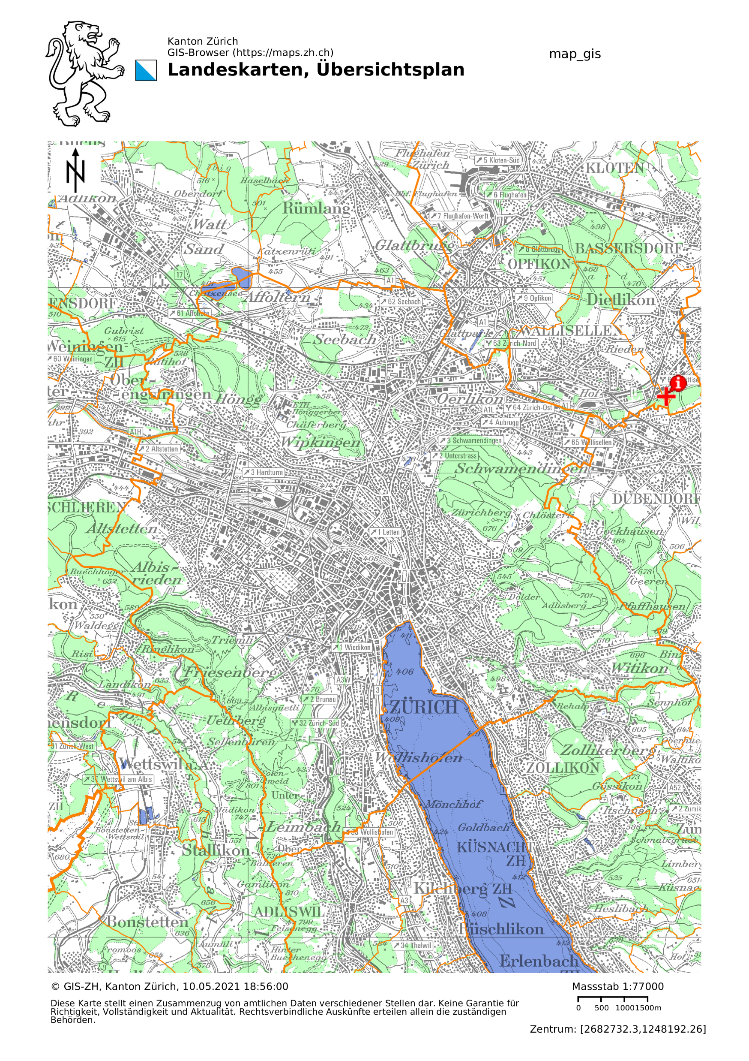
Introduction to Data Science Project Accident Analysis in Zurich David Linder, Marcelo Looser

Slide 2
Content
Introduction
Data preparation
Exploratory analysis
Classification
Kernel density estimation
Questions

Slide 3
Introduction
Questions that we tried to answer:
Which features in the data set are significant when accidents occur?
Can we classify certain features in dependence of a subset of other features?
Can we find the underlying probability distributions of the samples?
and what do they tell us?

Slide 4
Data preparation
The given data sets are quiet messy.
The goal is to clean up all the data sets and save them in destinct tables.
Link the data sets by certain features.
With additional merging in a separate table.

Slide 5
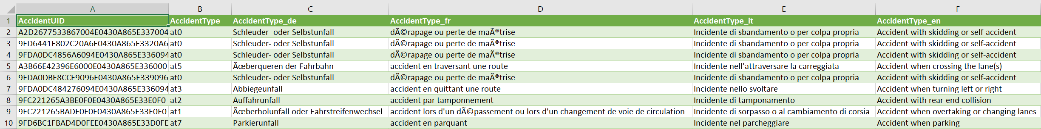
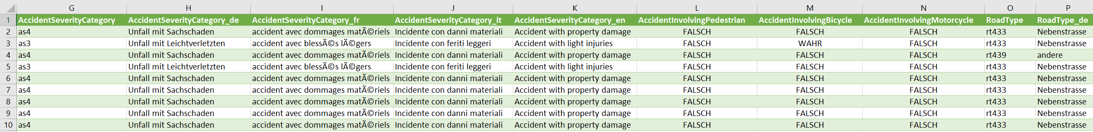
Data preparation, accidents in Zurich
Drop unimportant columns

Slide 6
Data preparation, accident data
Change strings to integer, and change false/true statements to 0/1

Slide 7
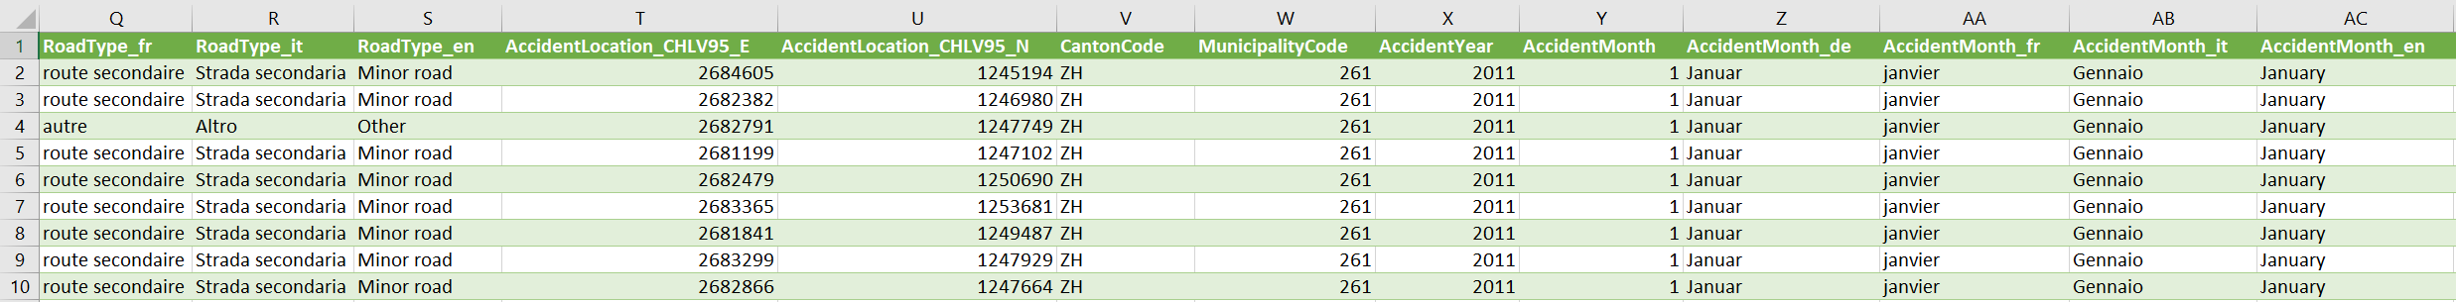
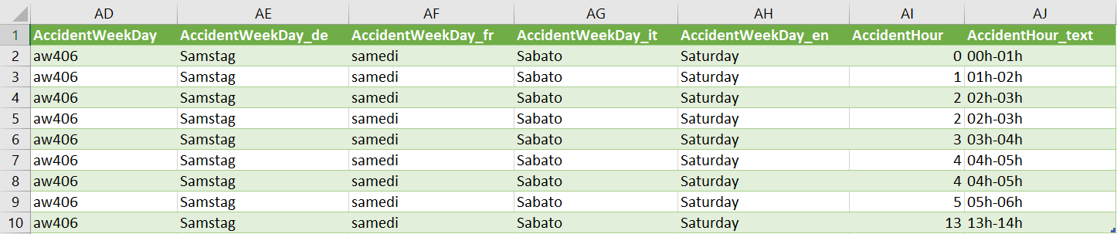
Data preparation, accident data
Merge date objects to one column called Date

Slide 8
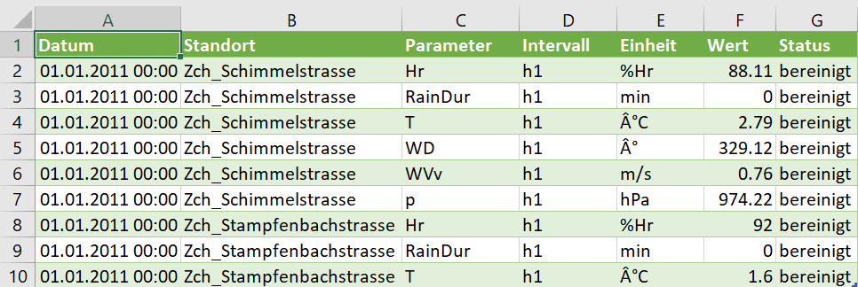
Data preparation, meteo data
Drop unimportant rows and columns
Take the average of the remaining data with respect to n measurement locations.

Slide 9
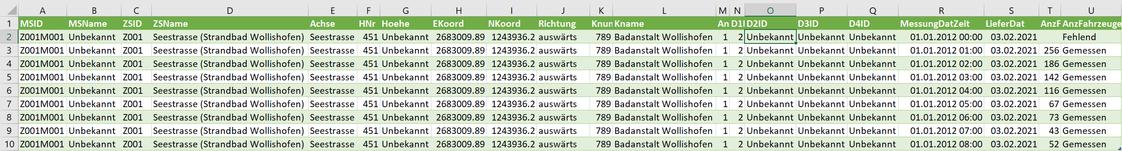
Data preparation, counts of cars on the road
Drop unimportant columns. (Note: nans were not dropped)

Slide 10
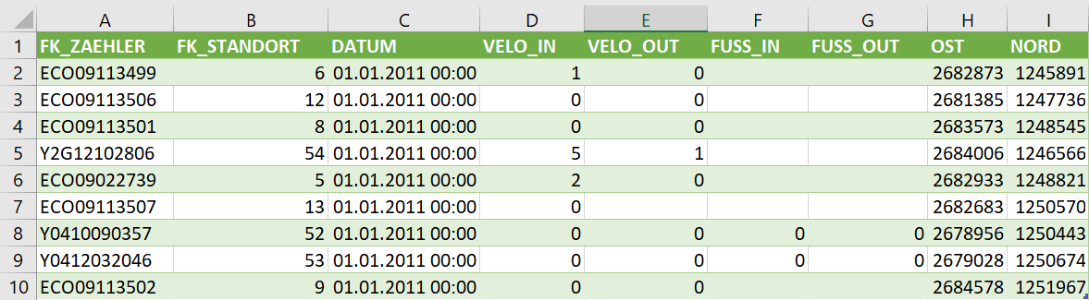
Data preparation, counts of pedestrians and bicycles on the road
Drop unimportant columns. (Note: nans were not dropped)
Add counts together on both sides of the lane to get the total.
The measurements were taken every 15 min; get the total for one hour.

Slide 11
Data preparation, merging
The average temperature and rain durations
were added to every accident according
to the date.
The count data sets were merged with
respect to the location and the date.
To do this, we located the counting
stations within a radius of 200m from
an accident.

Slide 12
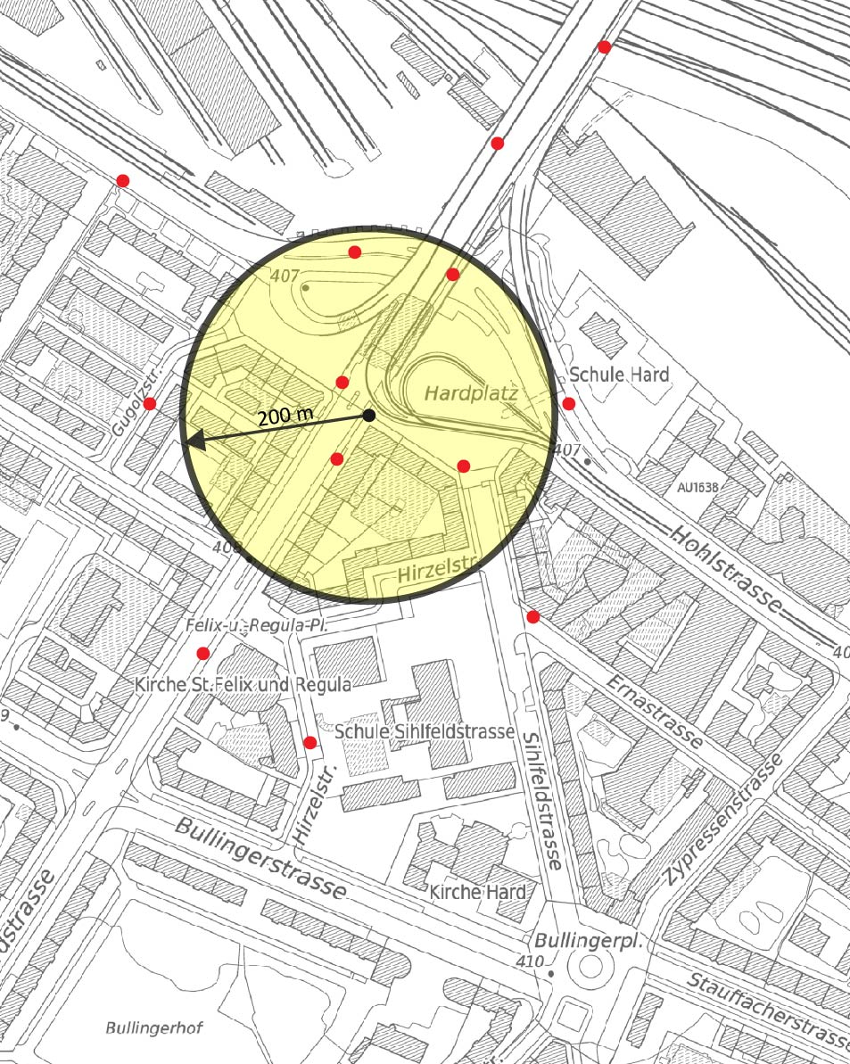
Data preparation, merging
The average temperature and rain dur-
ations were added to every accident
according to the date.
The count data sets were merged with
respect to the location and the date.
To do this, we located the counting
stations within a radius of 200m from
an accident.

Slide 13
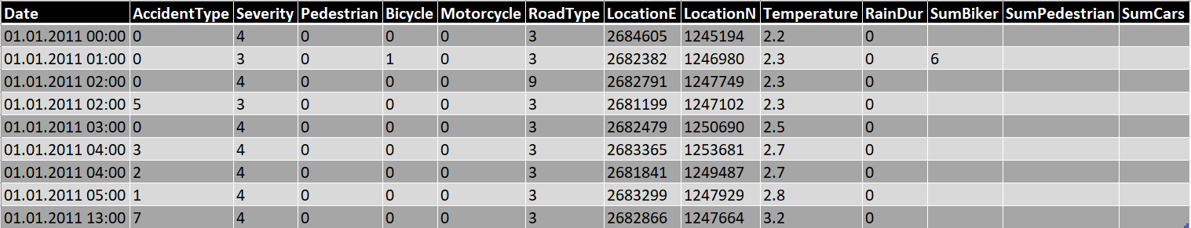
Data preparation
The merged and cleand data sets are now ready to undergo some analysis.

Slide 14
Exploratory analysis, technicalities
To get a grasp of the used data, we used the following Python modules/methods:
Quick Matplotlib plots.
Seaborn pair plot, to visualize immediate relations between the features.
Linear regression via statsmodels.
Kernel density estimation with default parameters in Seaborn, SciPy and
scikit-learn.
All with the help of pandas DataFrame class.

Slide 15
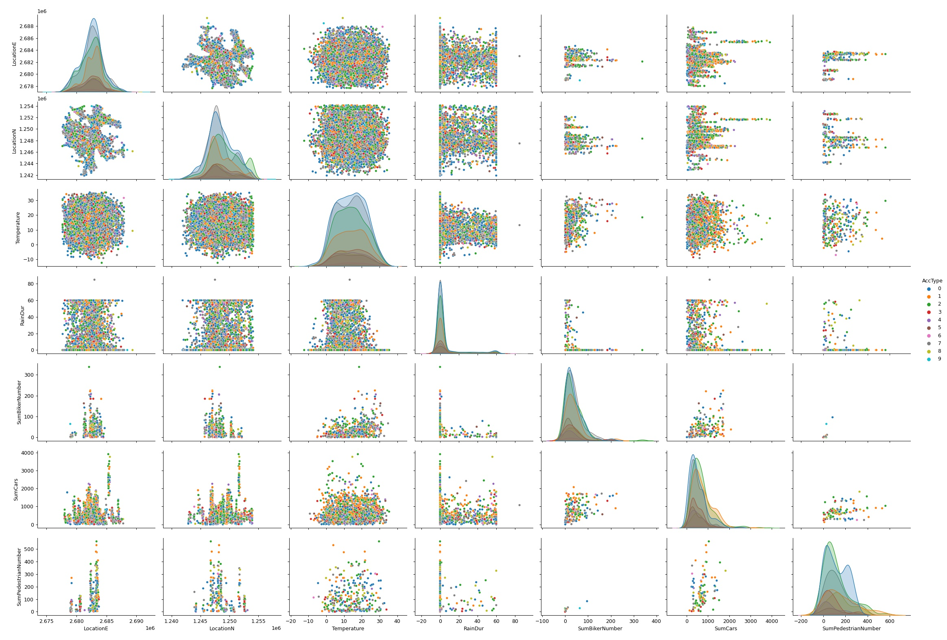
Exploratory analysis
0: Accident with skidding or self-accident
1: Accident when overtaking or changing lanes
2: Accident with rear-end collision
3: Accident when turning left or right
4: Accident when turning-into main road
5: Accident when crossing the lane(s)
6: Accident with head-on collision
7: Accident when parking
8: Accident involving pedestrian(s)
9: Accident involving animal(s)
SumPedestrian SumCar SumBicycle RainDur Temperature LocationN LocationE
LocationE LocationN Temperature RainDur SumBicycle SumCar SumPedestrian

Slide 16
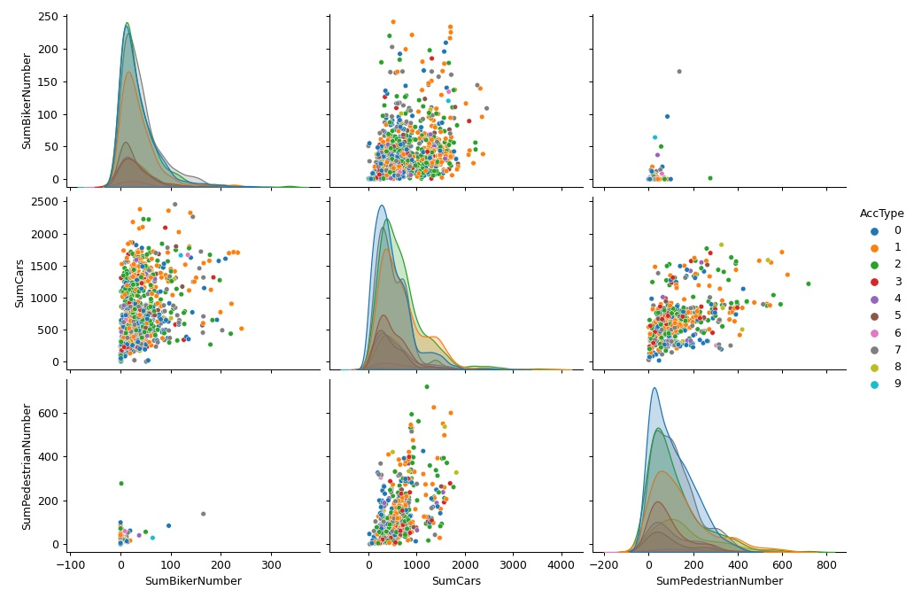
Exploratory analysis
There is no clear clustering
visible.
We se some trends in the
scatter plot, but only trivial
ones.

Slide 17
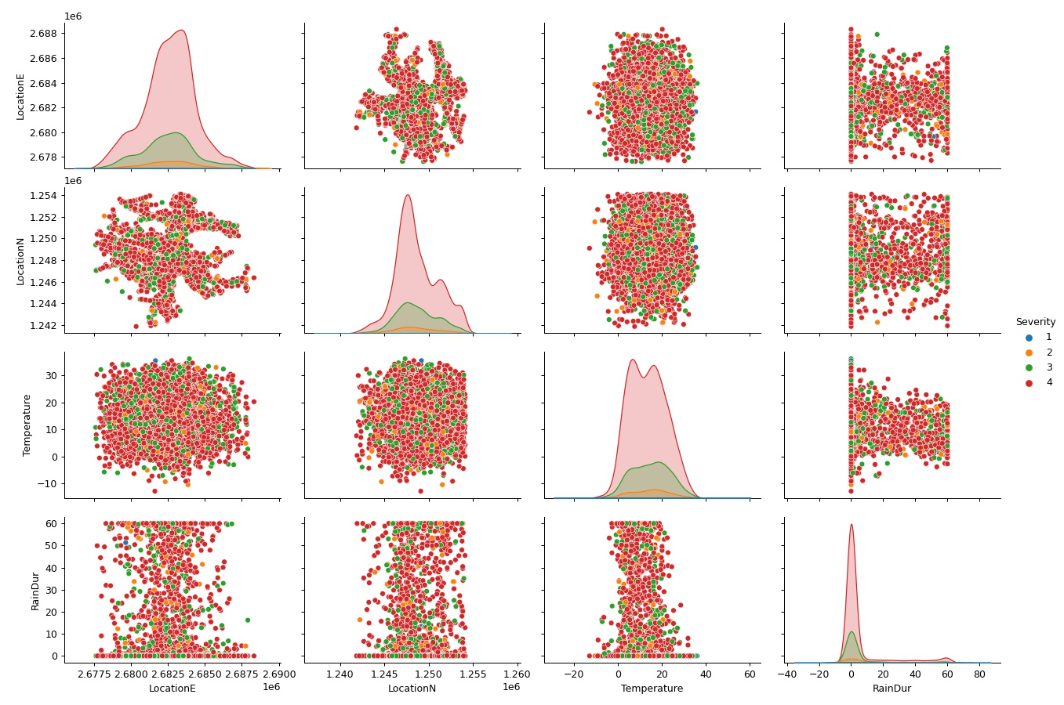
Exploratory analysis
Severity classes:
1: Accident with fatalities
2: Accident with severe injuries
3: Accident with light injuries
4: Accident with property damage
There is no clear cluster-
ing visible.
The class 4 seems to be
dominant.

Slide 18
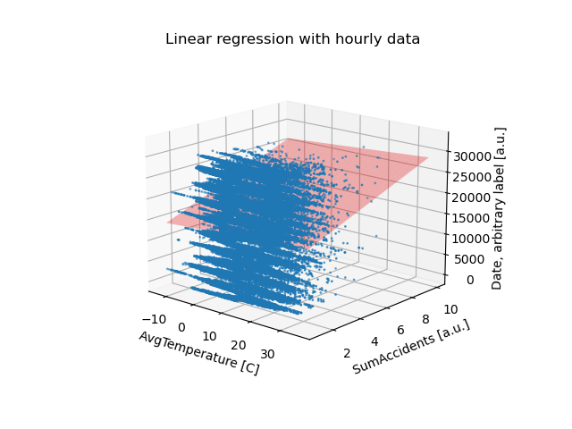
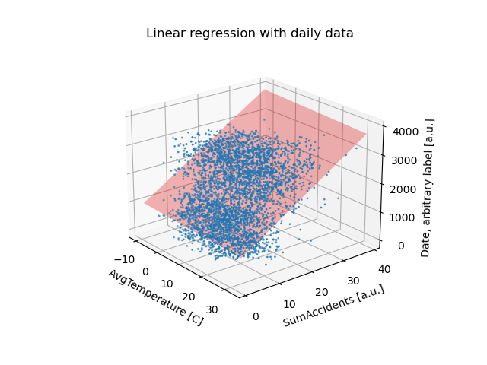
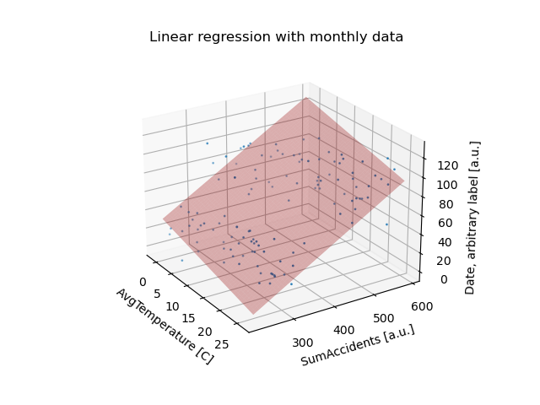
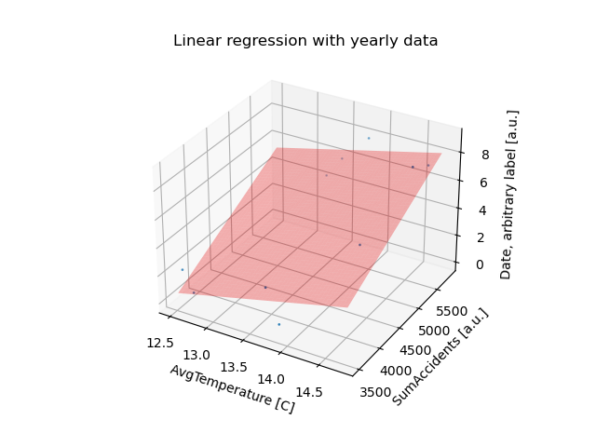
Exploratory analysis
We tried to find some relations via linear regression of a few non ordinal features.
But we have not pursued it further.

Slide 19
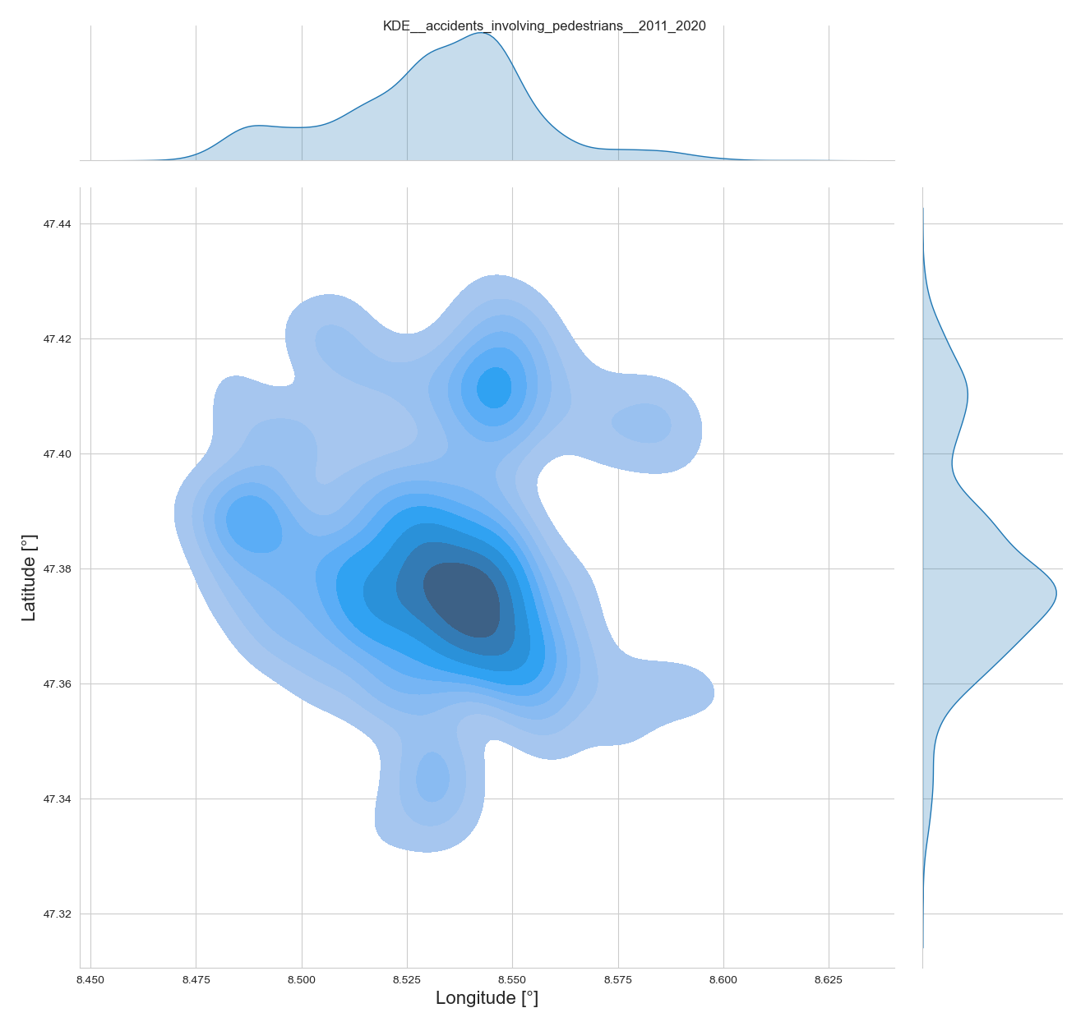
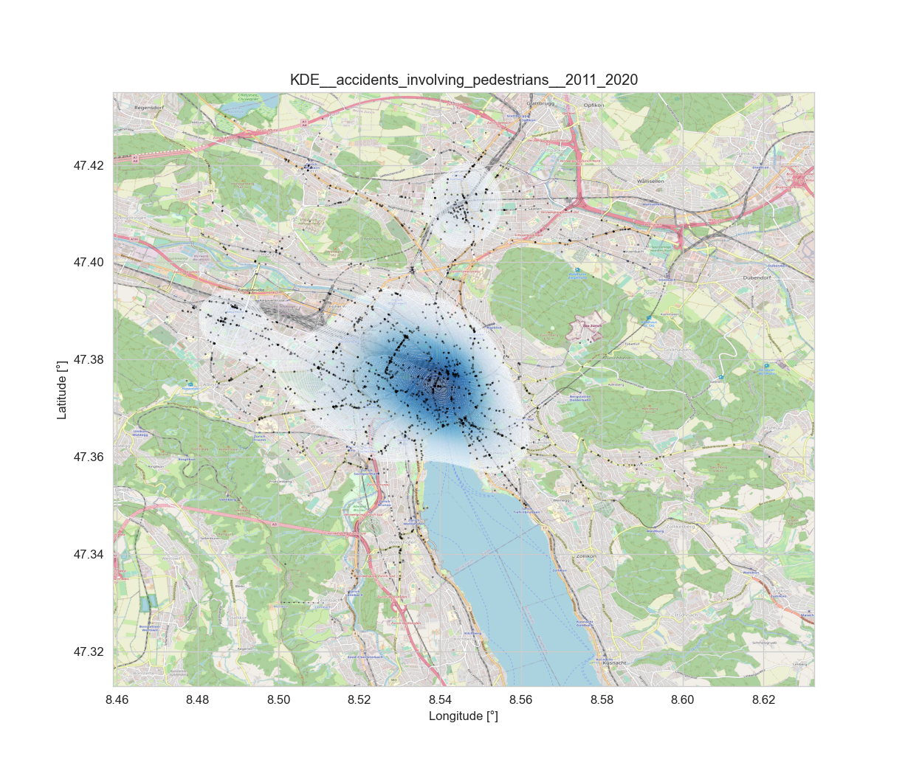
Exploratory analysis
To see the distribution of the data points in
addition with a probability density estimation,
we have plotted them on the map of Zurich.
We used Seaborn, SciPy and scikit-learn to do this.
Note the plots on the right are plotted via
Seaborn and SciPy.
For the exploratory part we only used the
default parameters.

Slide 20
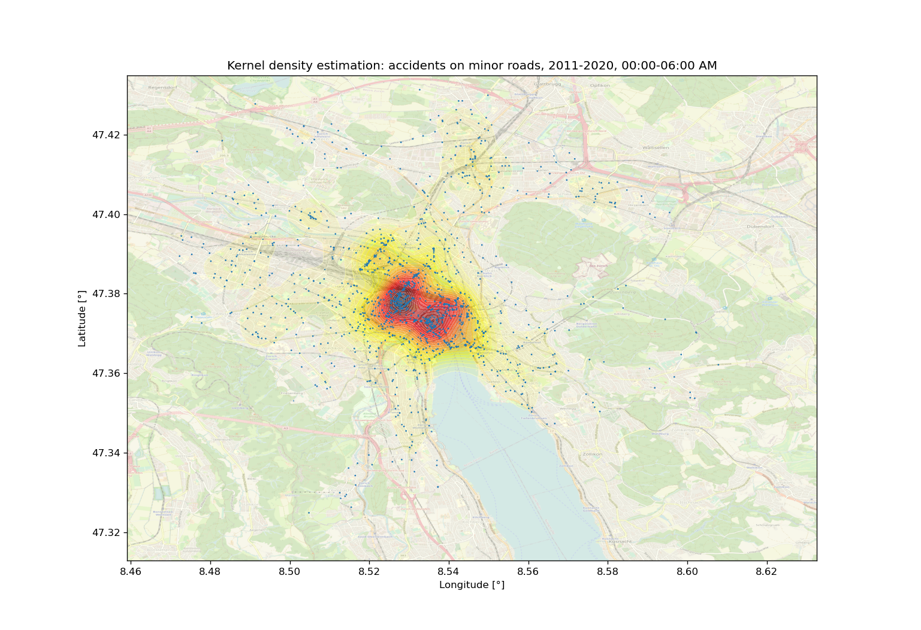
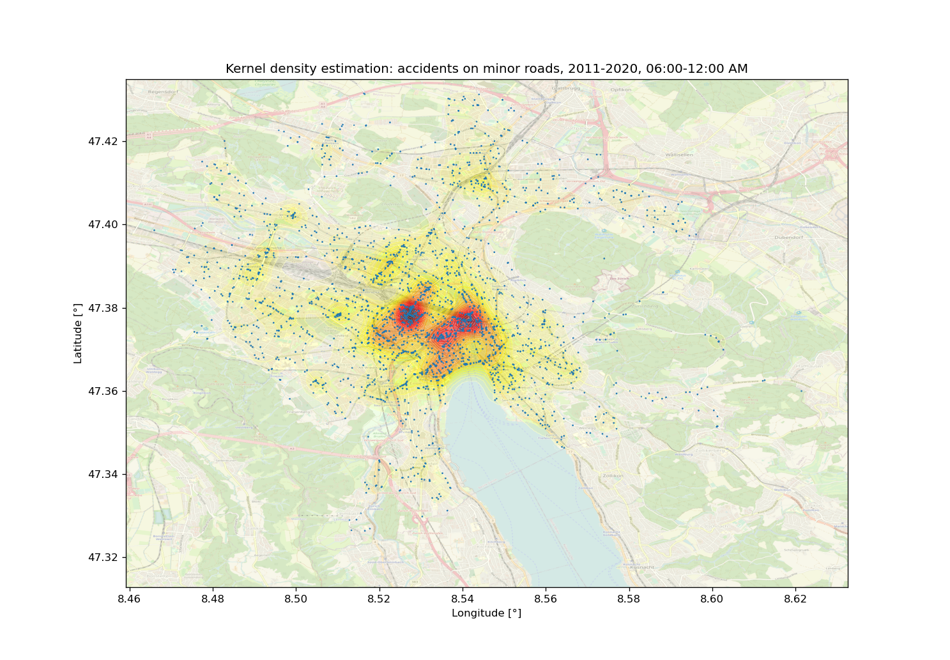
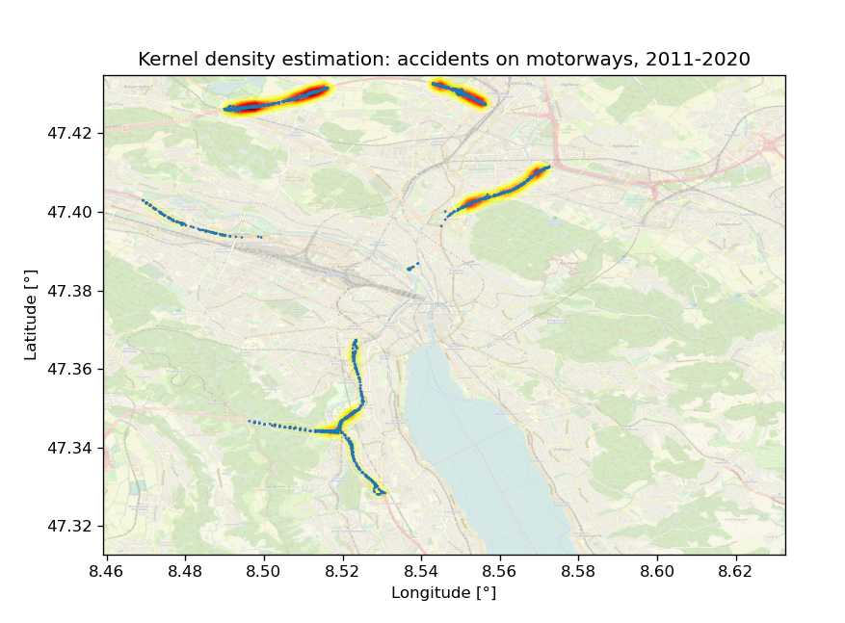
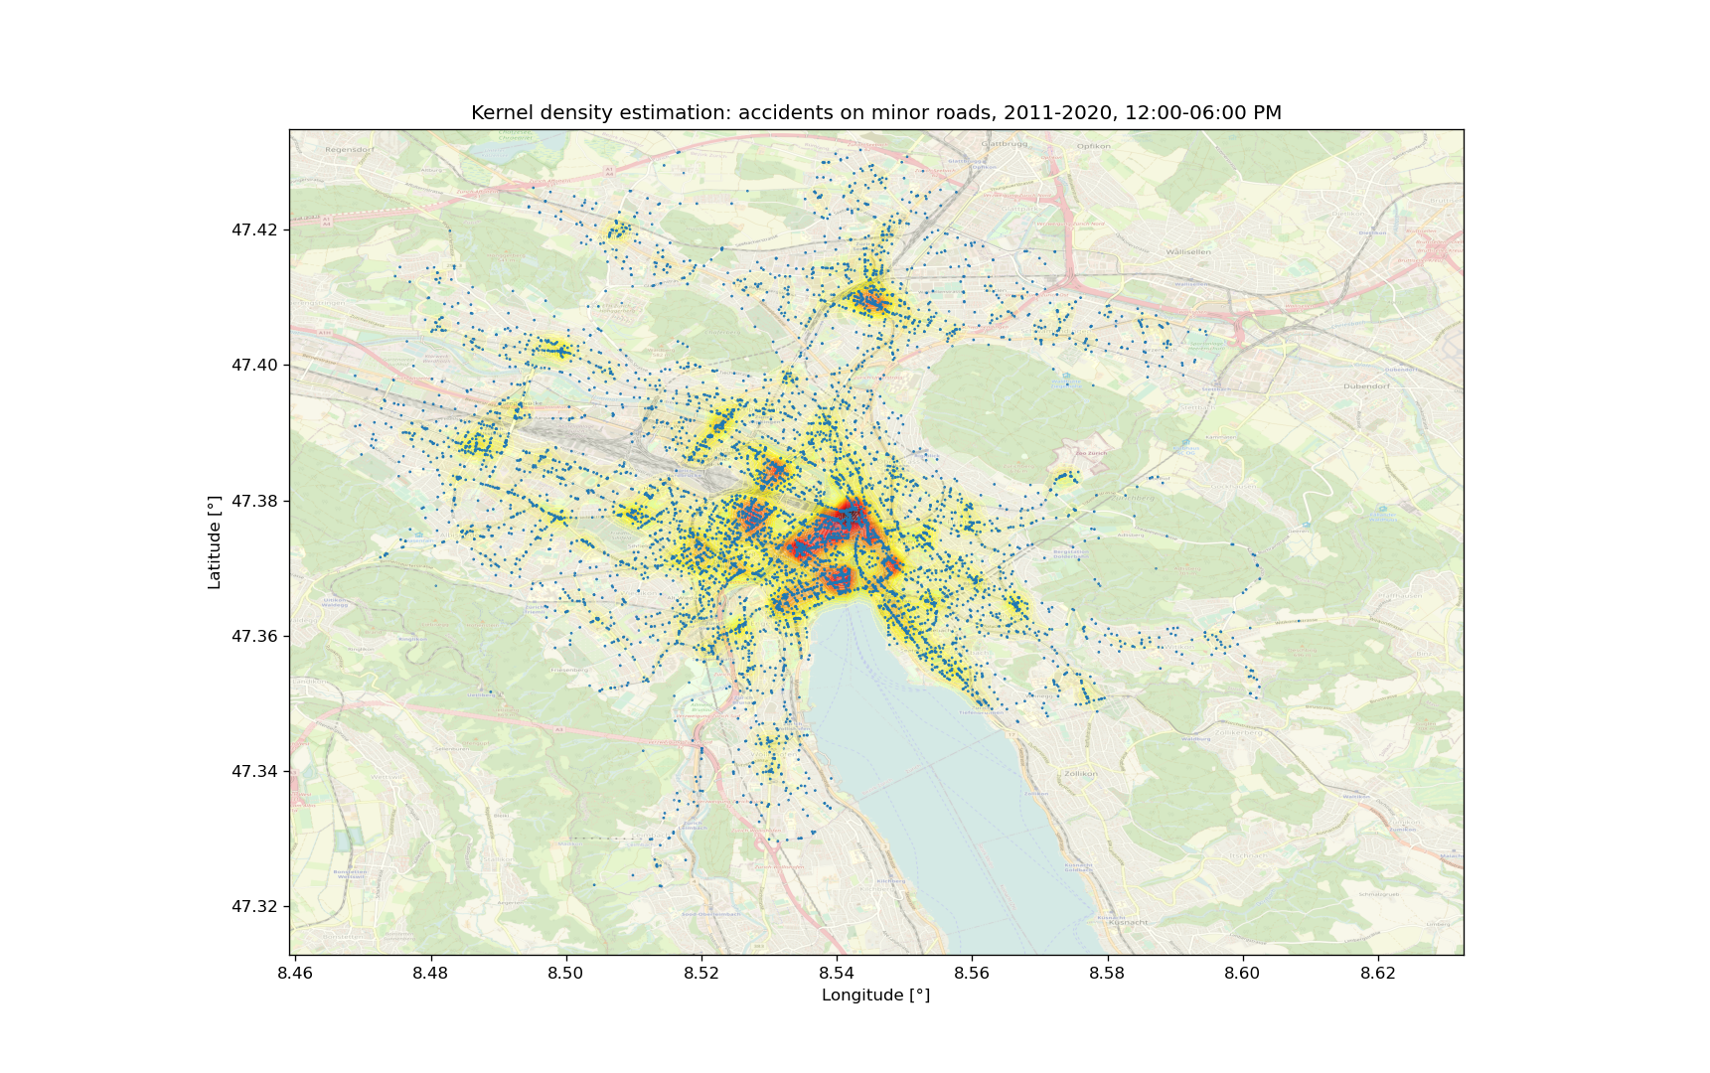
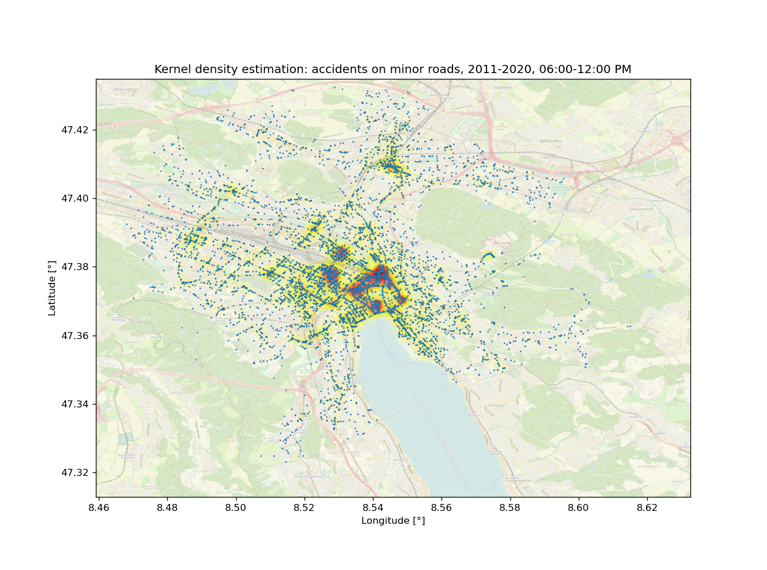
Exploratory analysis
We decided to use the scikit-learn implementation. Since we can use the implemented 2-fold cross validation to estimate the best bandwidth.

Slide 21
Classifications
Here we tried to predict three distinct features:
Severity
Accident type
Road type
This has been done via three different methods:
Decision tree
Random forest
Sequential model in Tensorflow

Slide 22
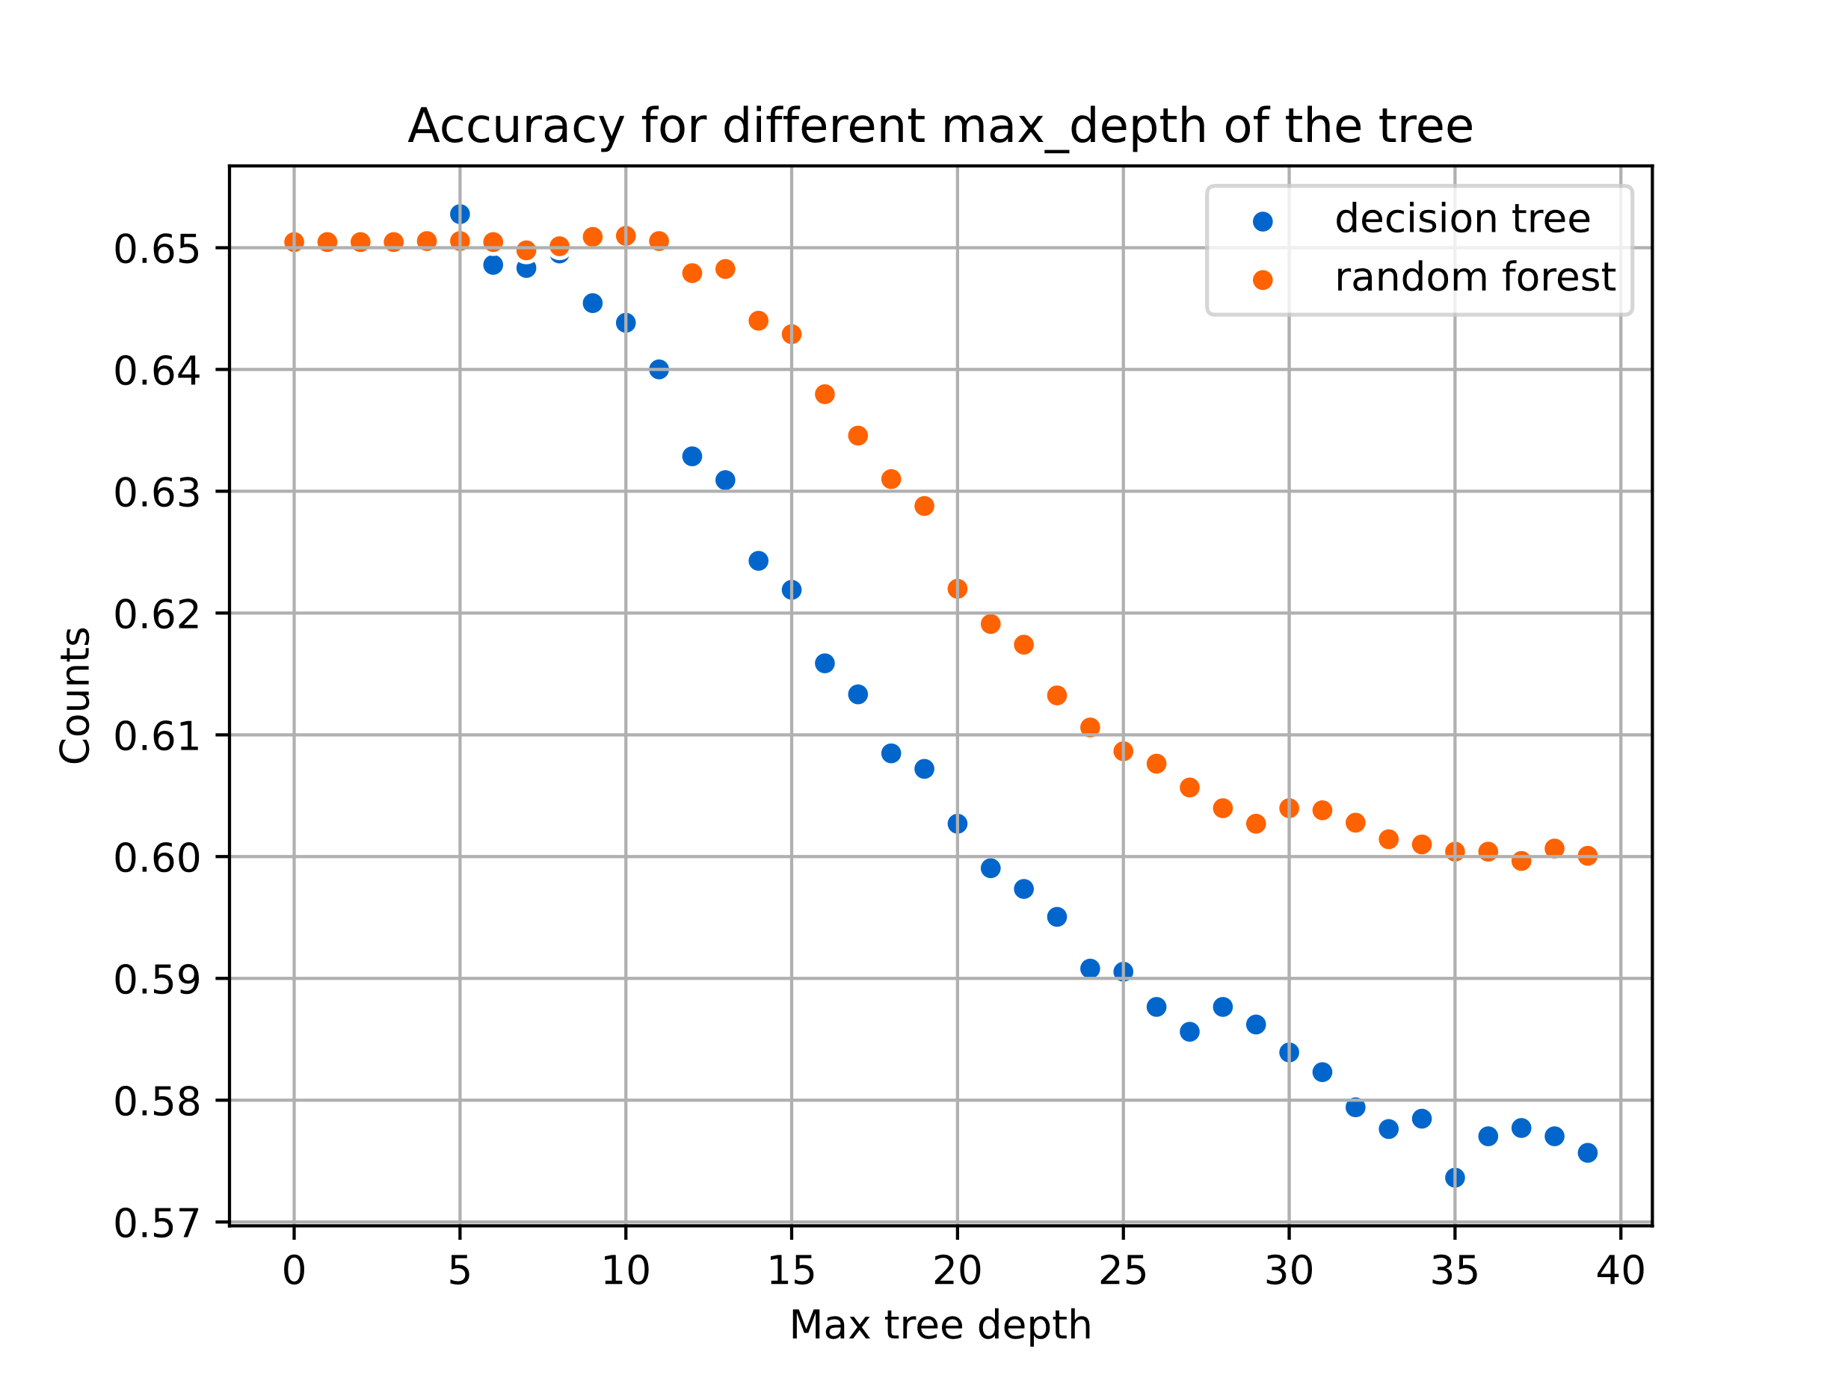
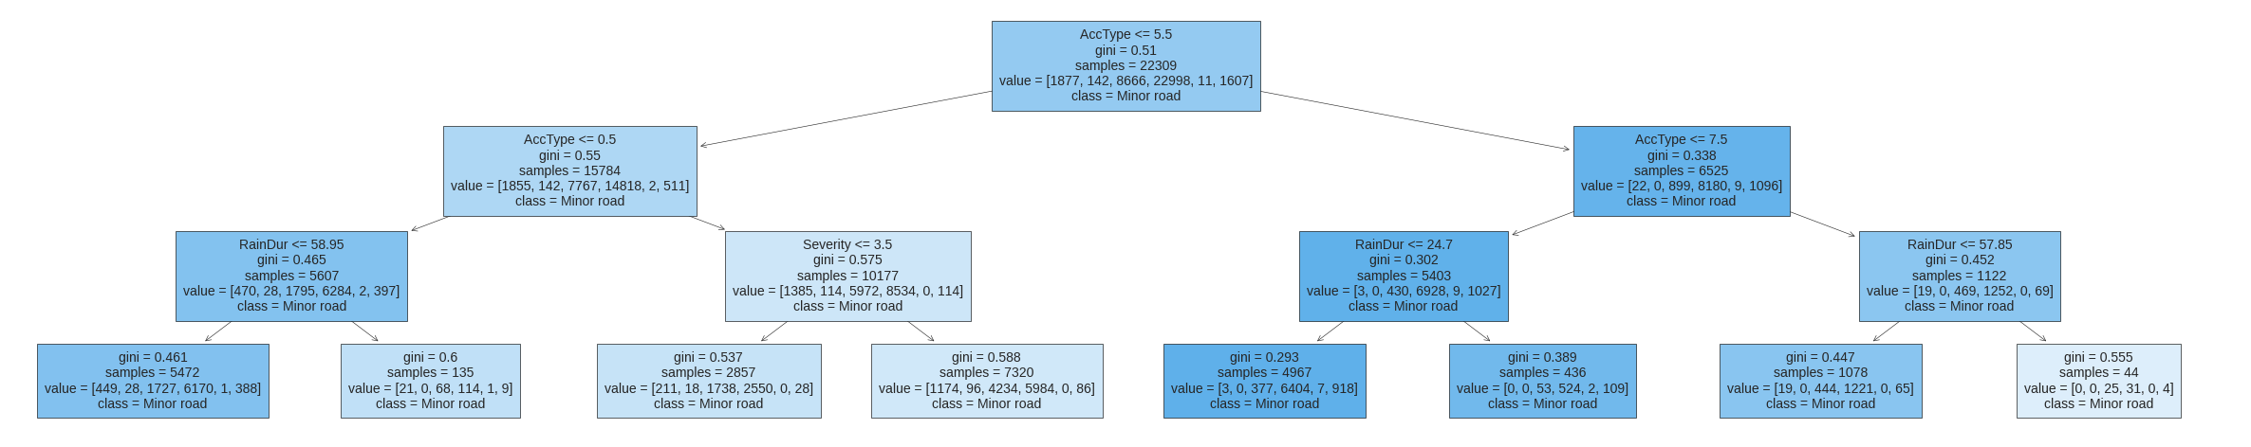
Classifications
This is a decision tree with a maximal depth of 3.
We also tried it with various other depths.

Slide 23
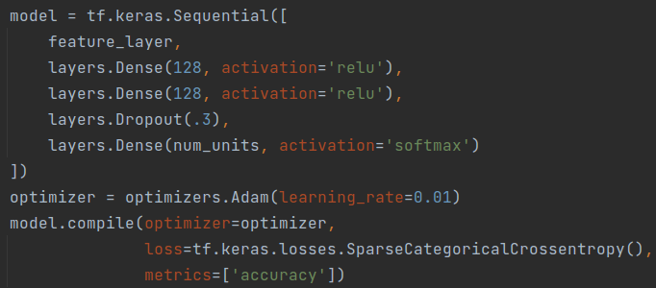
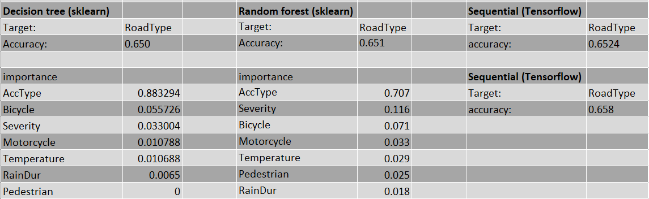
Classifications
Most important features used for sequential model:
['Severity', 'AccType', 'Bicycle']

Slide 24
Kernel density estimation
As mentioned before, 2-fold cross validation to find an estimation of the bandwidth of the kernel density.
Further, gaussian kernels were used.
To display them in a nice manner, we used a simple linear interpolation scheme between the calculated frames.

Slide 25
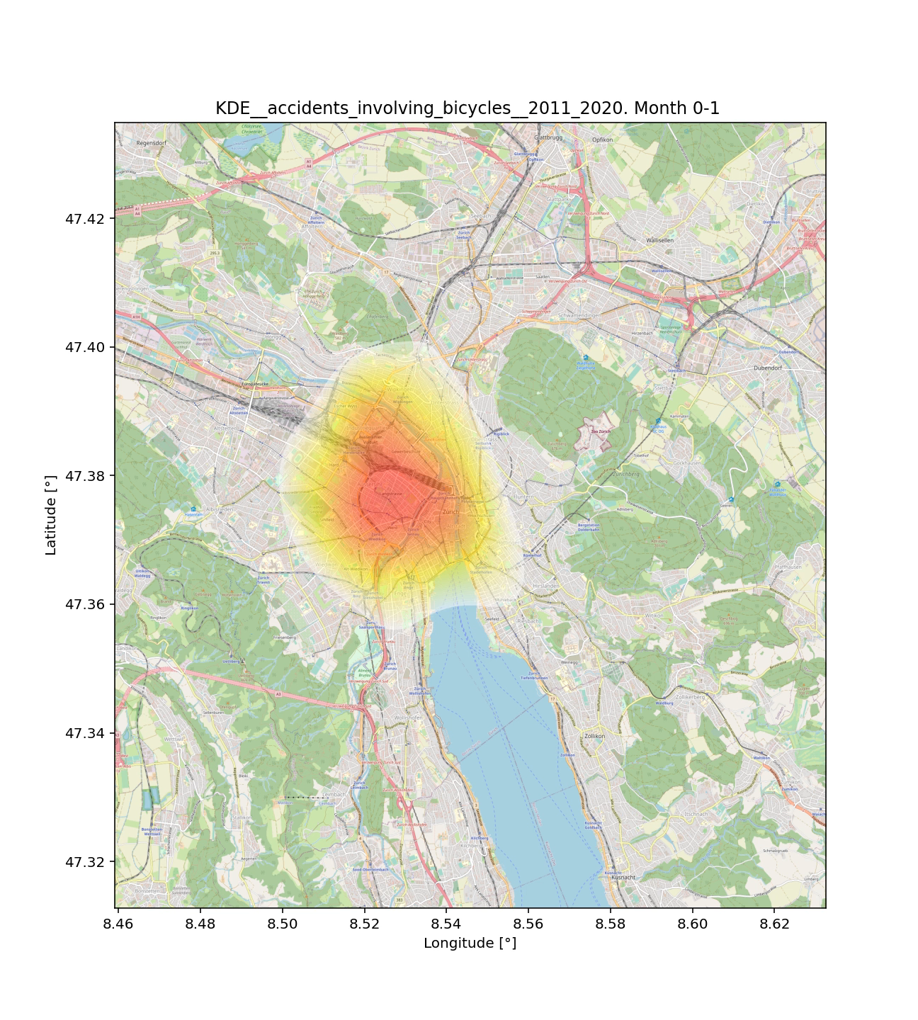
Kernel density estimation

Slide 26
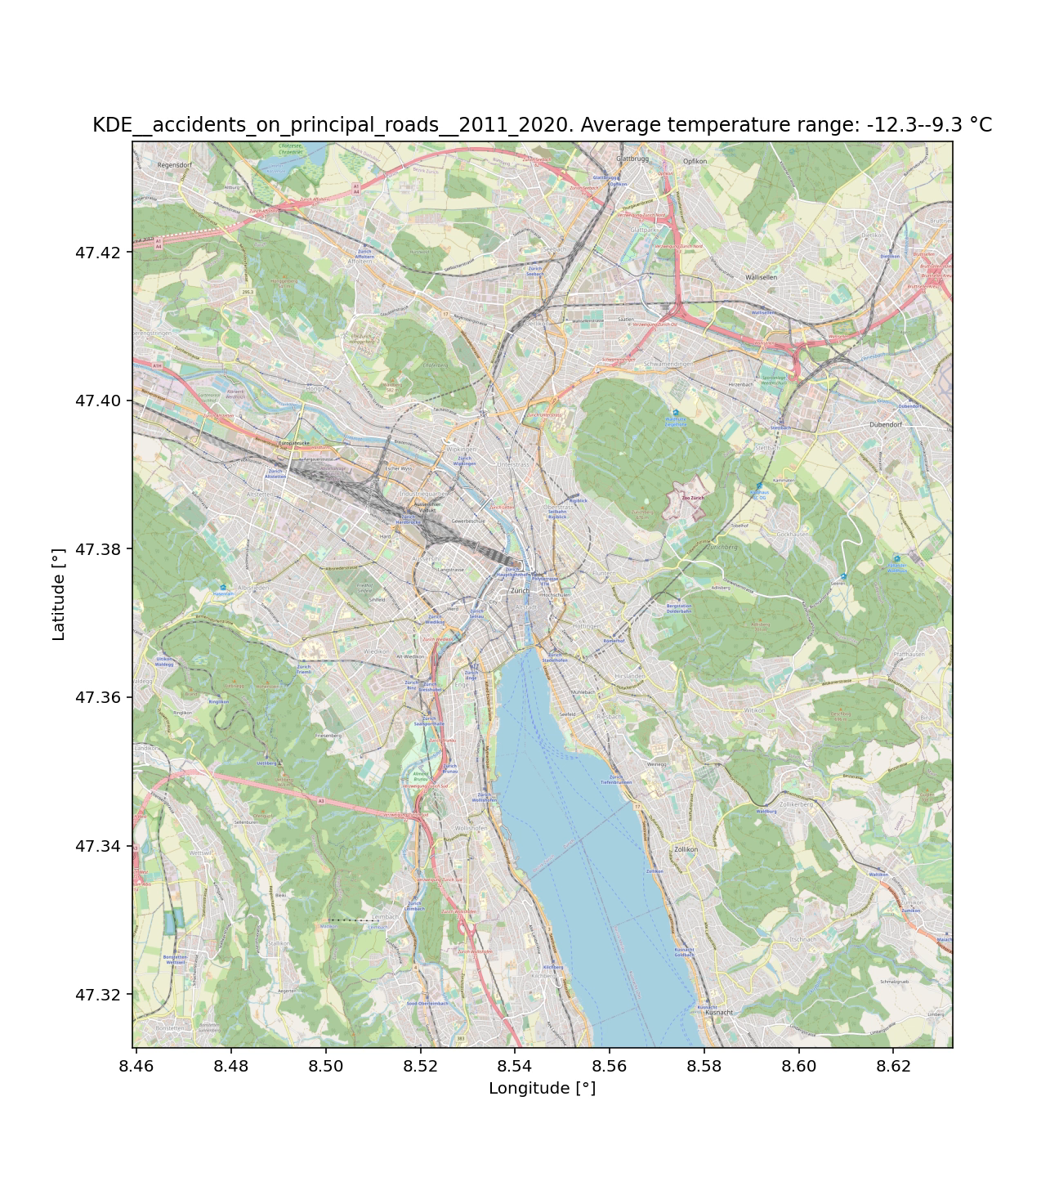
Kernel density estimation

Slide 27
Questions ?

Slide 28
References
The git repository can be found here: https://github.com/massstab/ESC403_project.git
Also the raw data and instructions how to tidy up the data and the codebook with the explanation of all labels can be found there.
The main accidents dataset can be found here: https://opendata.swiss/de/dataset/polizeilich-registrierte-verkehrsunfalle-auf-dem-stadtgebiet-zurich-seit-2011/resource/3bf3f12a-bf09-4e69-8cde-0df9e268d54b
The meteo data can be found here: https://data.stadt-zuerich.ch/dataset/ugz_meteodaten_stundenmittelwerte
The count of the pedestrian/cars/bike data can be found here: https://data.stadt-zuerich.ch/dataset/ted_taz_verkehrszaehlungen_werte_fussgaenger_velo
The used Zurich maps were taken from: https://maps.zh.ch/

Slide 29
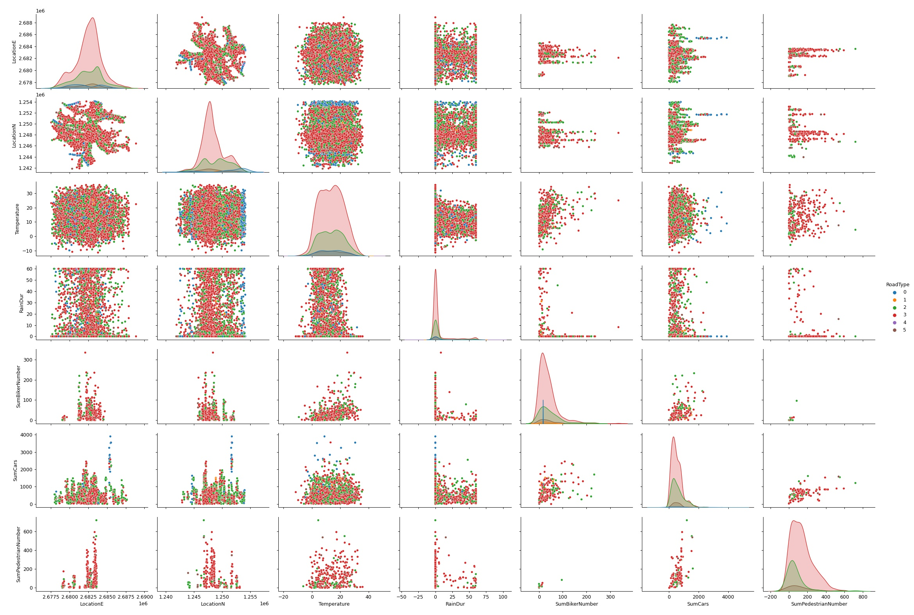
Appendix

Slide 30
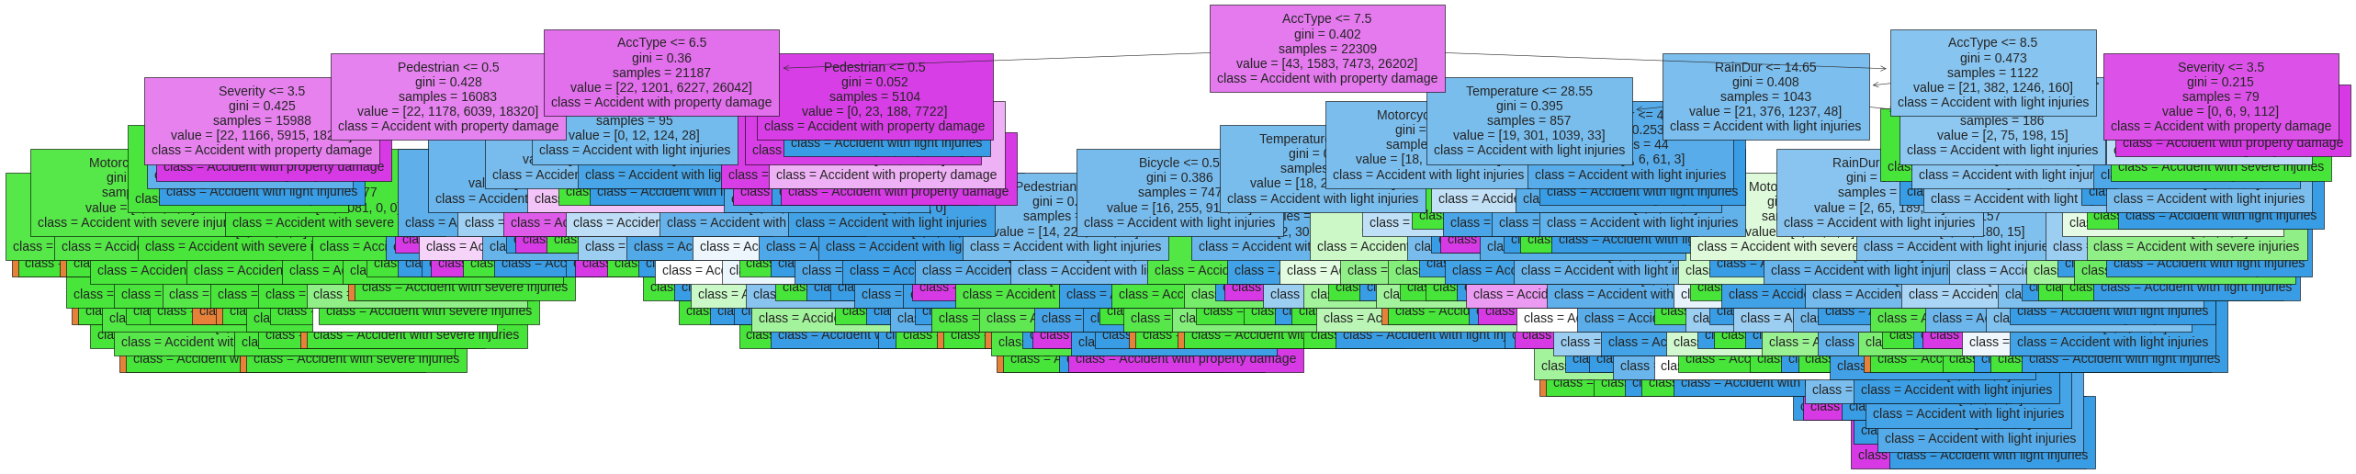
Appendix

Slide 31
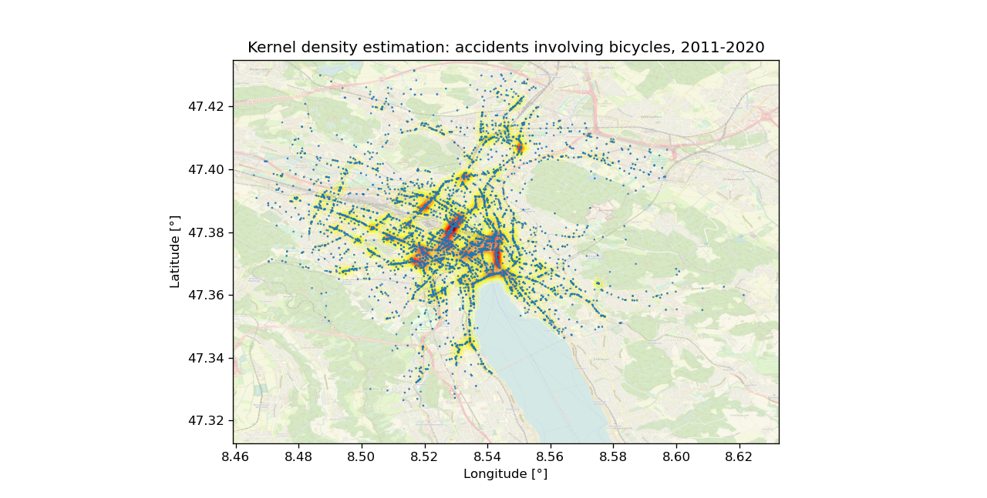
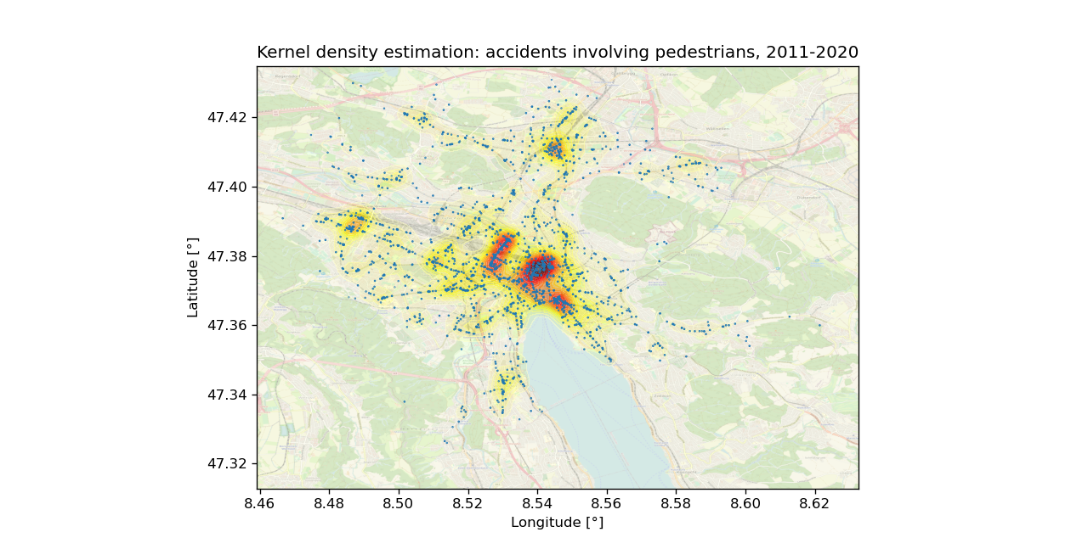
Appendix
Small subset of made KDEs

Slide 32
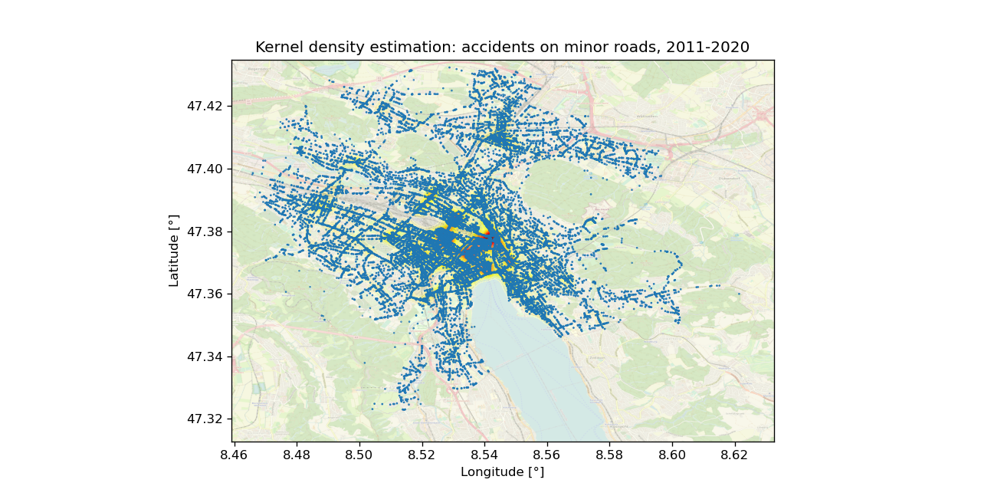
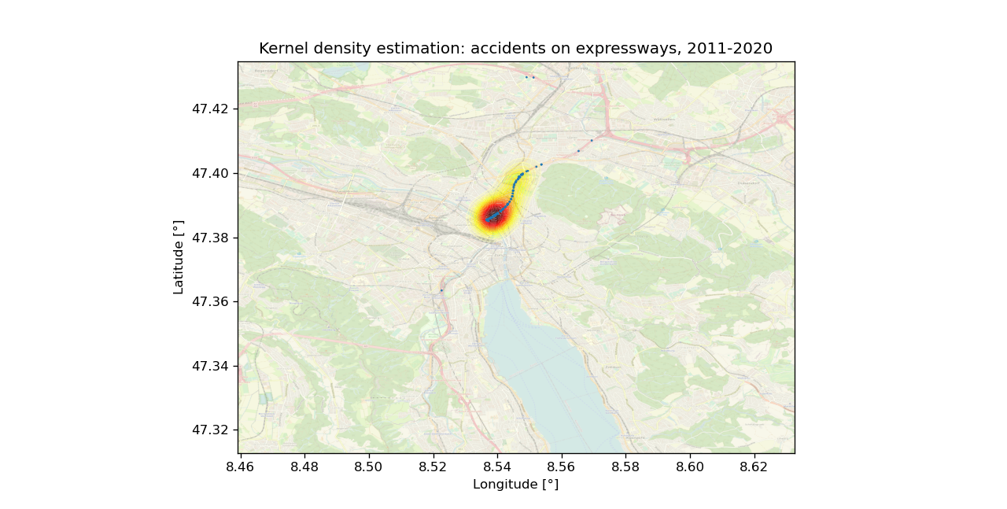
Appendix
Small subset of made KDEs

Slide 33
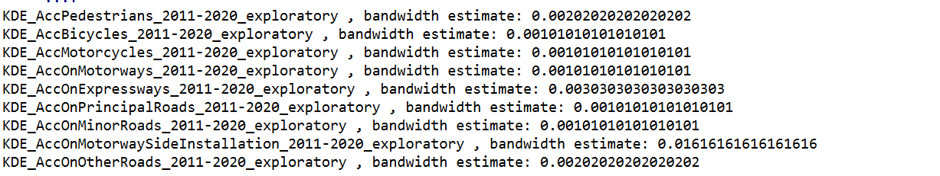
Appendix
Small subset of made KDEs, best bandwidth estimation
The bandwidth were chosen in a range of [0, 0.1] with 256 values

Slide 34
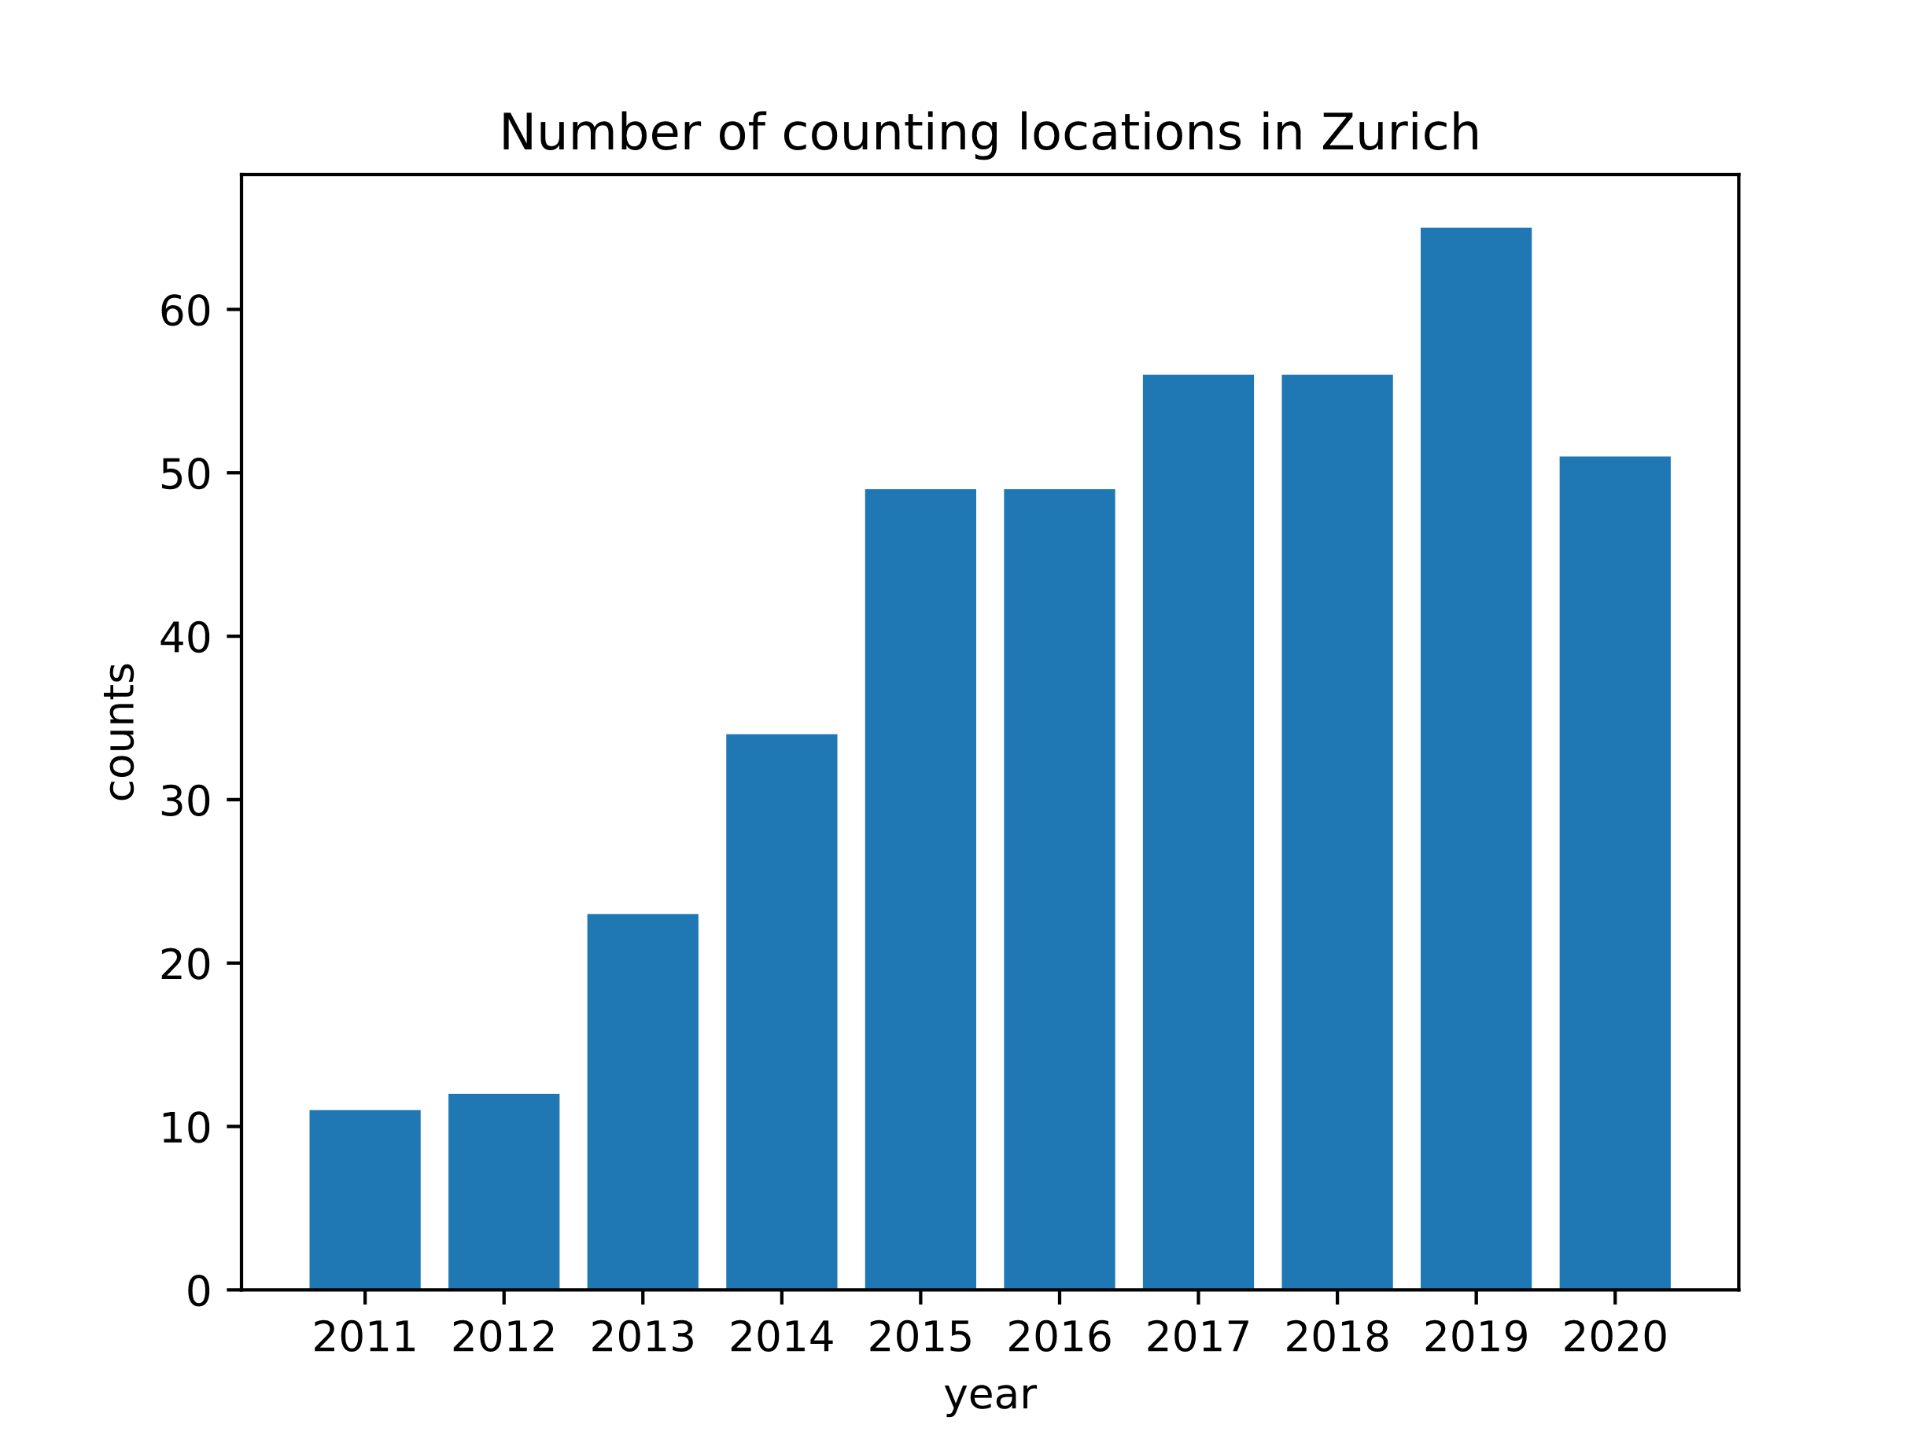
Appendix

